Slide 1
Internet of Everything (IoE)
Dr. Vinayak Ashok Bharadi

Slide 2
Sensors
What are the sensors?
Sensor Family
Architecture of a Single Node Sensor.

Slide 3
Sensors
Sensors are sophisticated devices that are frequently used to detect and respond to electrical or optical signals. A Sensor converts the physical parameter (for example: temperature, blood pressure, humidity, speed, etc.) into a signal which can be measured electrically.
In the broadest definition, a sensor is a device, module, machine, or subsystem whose purpose is to detect events or changes in its environment and send the information to other electronics, frequently a computer processor. A sensor is always used with other electronics.

Slide 4
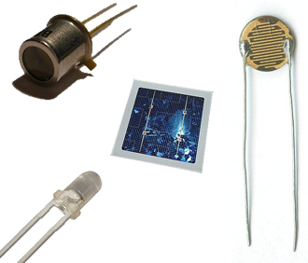

Slide 5
Criteria to choose a Sensor
1. Accuracy
2. Environmental condition – usually has limits for temperature/ humidity
3. Range – Measurement limit of sensor
4. Calibration – Essential for most of the measuring devices as the readings changes with time
5. Resolution – Smallest increment detected by the sensor
6. Cost
7. Repeatability – The reading that varies is repeatedly measured under the same environment

Slide 6
Classification of Sensors
The sensors are classified into the following criteria:
1. Primary Input quantity (Measurand)
2. Transduction principles (Using physical and chemical effects)
3. Material and Technology
4. Property
5. Application

Slide 7
Classification based on property is as given below:
Temperature – Thermistors, thermocouples, RTD’s, IC and many more.
Pressure – Fibre optic, vacuum, elastic liquid based manometers, LVDT, electronic.
Flow – Electromagnetic, differential pressure, positional displacement, thermal mass, etc.
Level Sensors – Differential pressure, ultrasonic radio frequency, radar, thermal displacement, etc.
Proximity and displacement – LVDT, photoelectric, capacitive, magnetic, ultrasonic.

Slide 8
Biosensors – Resonant mirror, electrochemical, surface Plasmon resonance, Light addressable potentio-metric.
Image – Charge coupled devices, CMOS
Gas and chemical – Semiconductor, Infrared, Conductance, Electrochemical.
Acceleration – Gyroscopes, Accelerometers.
Others – Moisture, humidity sensor, Speed sensor, mass, Tilt sensor, force, viscosity.

Slide 9
Classification based on Application is as given below:
Industrial process control, measurement and automation
Non-industrial use – Aircraft, Medical products, Automobiles, Consumer electronics, other type of sensors

Slide 10
Sensors can be classified based on power or energy supply requirement of the sensors:
Active Sensor – Sensors that require power supply are called as Active Sensors. Example: LiDAR (Light detection and ranging), photoconductive cell.
Passive Sensor – Sensors that do not require power supply are called as Passive Sensors. Example: Radiometers, film photography.

Slide 11
In the current and future applications, sensors can be classified into groups as follows:
Accelerometers – These are based on the Micro Electro Mechanical sensor technology. They are used for patient monitoring which includes pace makers and vehicle dynamic systems.
Biosensors – These are based on the electrochemical technology. They are used for food testing, medical care device, water testing, and biological warfare agent detection.
Image Sensors – These are based on the CMOS technology. They are used in consumer electronics, biometrics, traffic and security surveillance and PC imaging.
Motion Detectors – These are based on the Infra Red, Ultrasonic, and Microwave / radar technology. They are used in videogames and simulations, light activation and security detection.

Slide 12
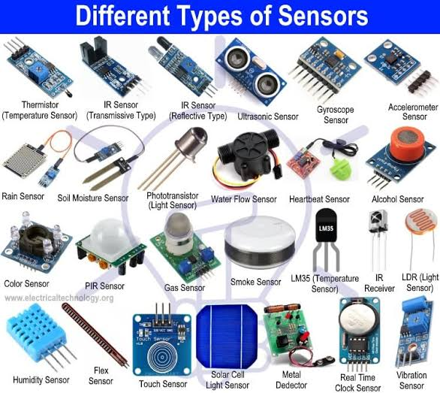

Slide 13
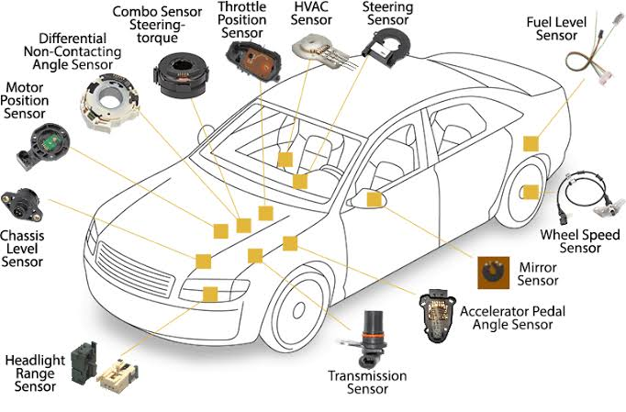

Slide 14
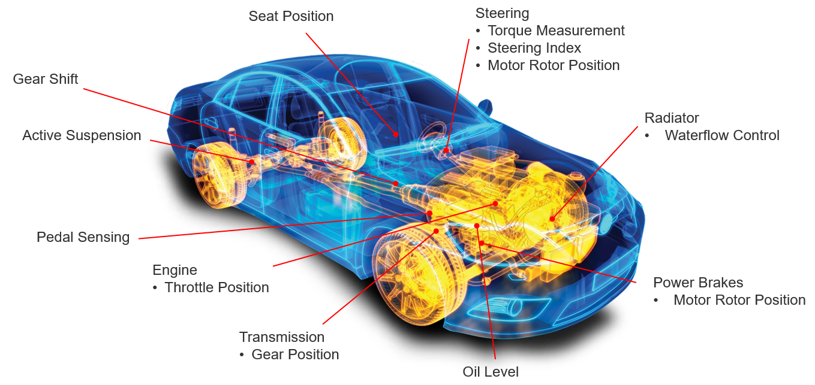

Slide 15
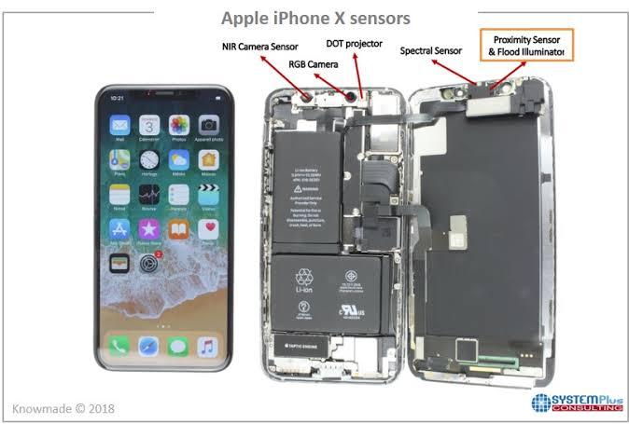

Slide 16
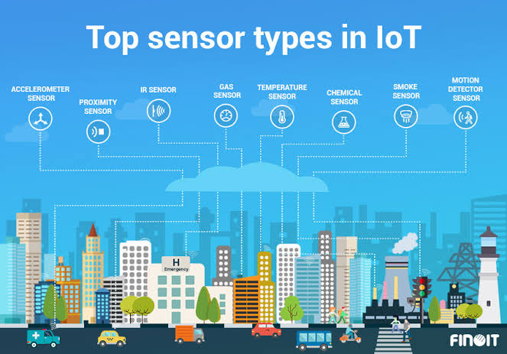

Slide 17
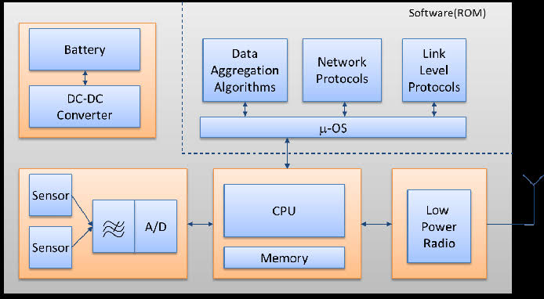
Wireless Sensor Node

Slide 18
References
https://www.engineersgarage.com/article_page/sensors-different-types-of-sensors/

